Slide 1
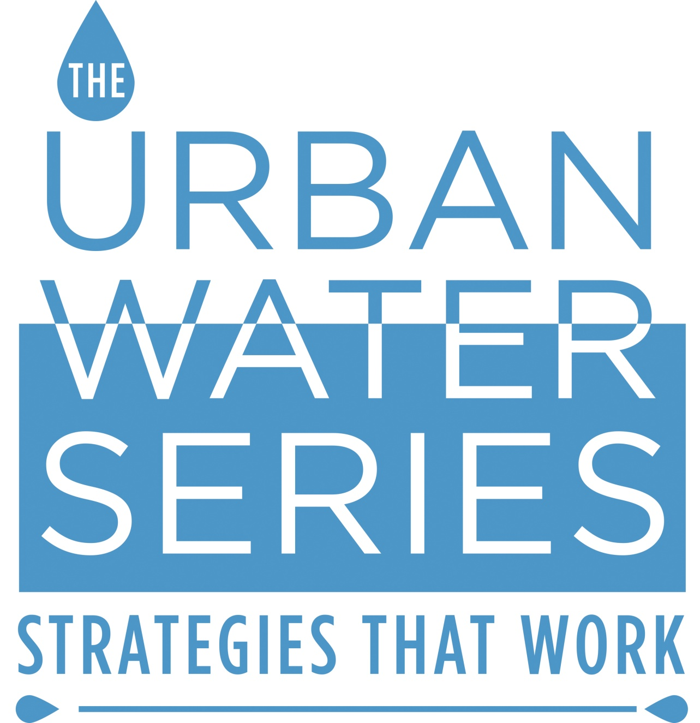
#UrbanWaterSeries

Slide 2
Metropolitan & Comprehensive Green Stormwater Strategies
Julie Slavet, Executive Director
Tookany/Tacony-Frankford Watershed Partnership, Inc. (TTF)

Slide 3
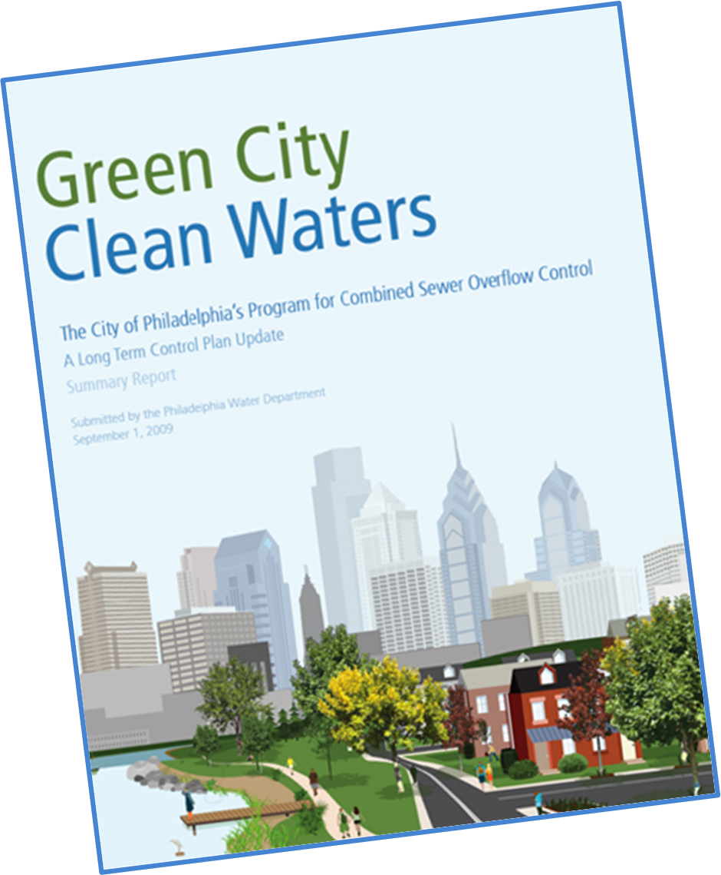
What & Why is TTF?
Notes:
TTF was established by PWD and partners to ensure that while the work of GCCW was going on downstream, upstream improvement was happening as well. TTF is the tool to make that happen.

Slide 4
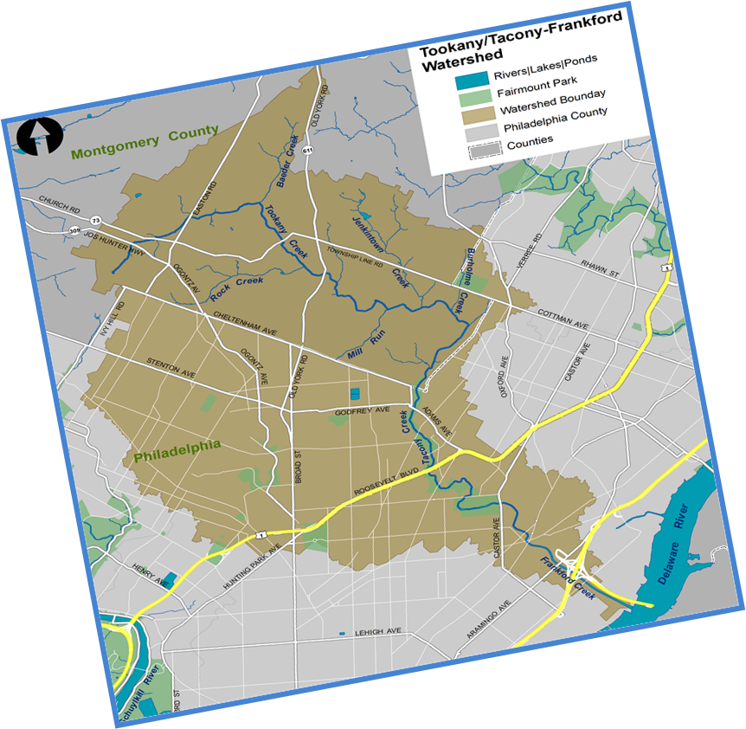
Challenges
Notes:
30 square-mile watershed shared by five municipal governments with varying structures and resources. Headwaters in more than one community. TTF watershed is source of water for Delaware River, one of Philadelphia’s sources of water. But drinking water for other watershed communities is from a different watershed.

Slide 5
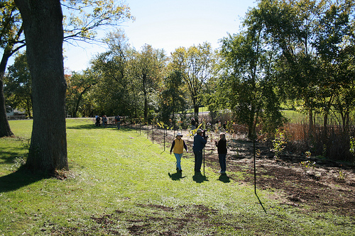
Demographics & Development
Notes:
Thirty percent of City is low income. Upstream communities are suburban and more affluent. Language and ethnicity vary across watershed communities. City streams are covered and in urban parks. Suburban streams are owned by schools, in parks, in backyards.

Slide 6
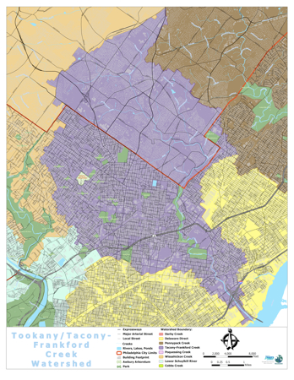
Boundaries
Notes:
Different types of governments, resources, priorities. Watershed communities are located in more than one watershed with different regulatory requirements.

Slide 7
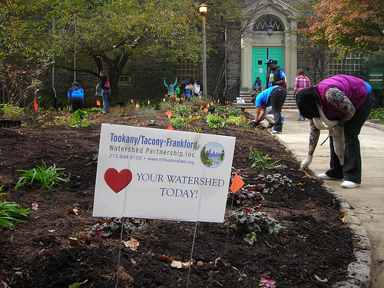
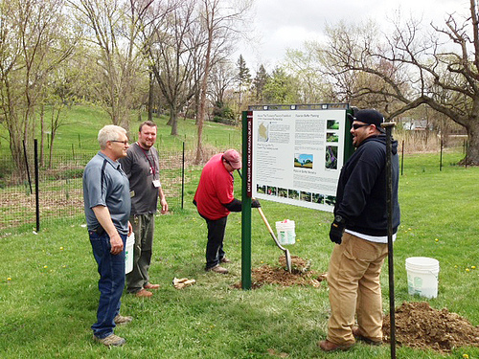
Tools
Rain Gardens
Riparian Buffers
Notes:
Watershed is source of drinking water for only half of watershed.

Slide 8
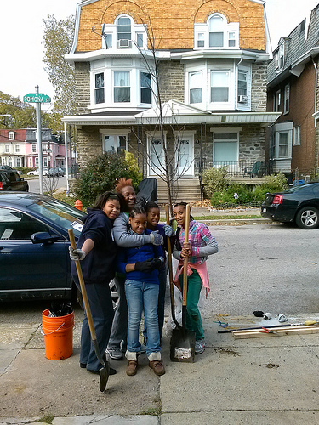
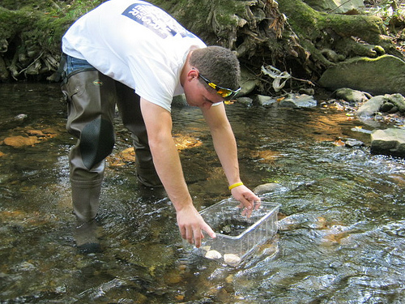
Tools
Trees!
Mussel Surveying

Slide 9
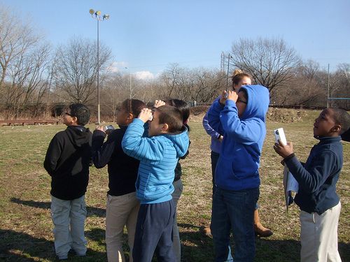
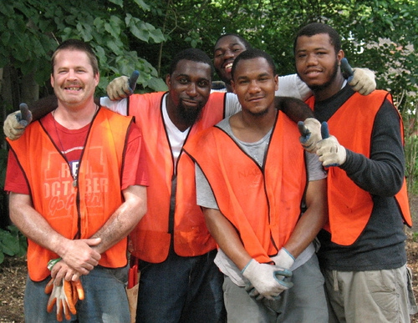
Tools
Nature & Bird Walks
Job Training

Slide 10
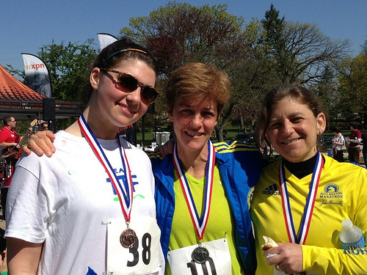
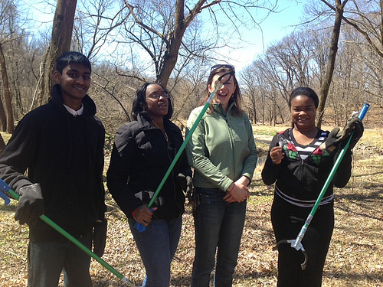
Tools
Recreation
Watershed Heroes!

Slide 11
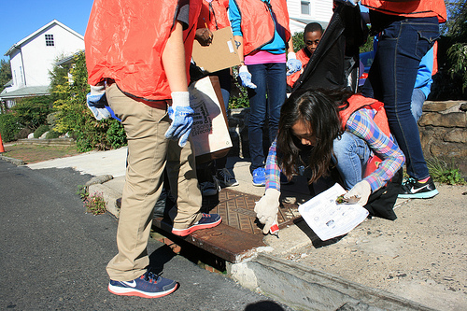
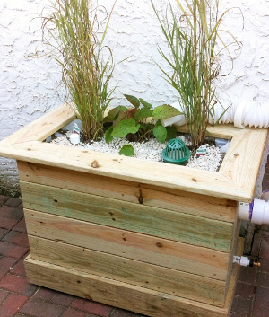
Tools
Storm Drain Marking
Green City Clean Waters

Slide 12
Meeting Needs & Speaking Words that Work
Access to green space & nature
Recreation
Neighborhood safety
Beautification
Flooding
Clean Water
Internships & jobs
Regulatory Compliance

Slide 13
Partners
Philadelphia Water Department
Philadelphia Parks & Recreation
Pennsylvania Horticultural Society
Audubon PA
Partnership for Delaware Estuary
Schools
Pennsylvania Environmental Council

Slide 14
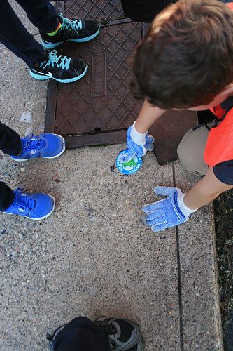
What Next?
Notes:
Building stewardship and improvement in measurable ways. Support from William Penn Foundation. Water “campaign”. This is new, chance to learn from mistakes!

