Slide 1

www.gnof.org/urbanwaterseries

Slide 2
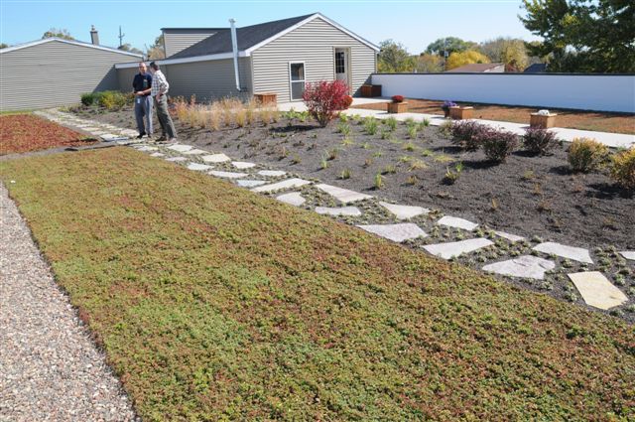
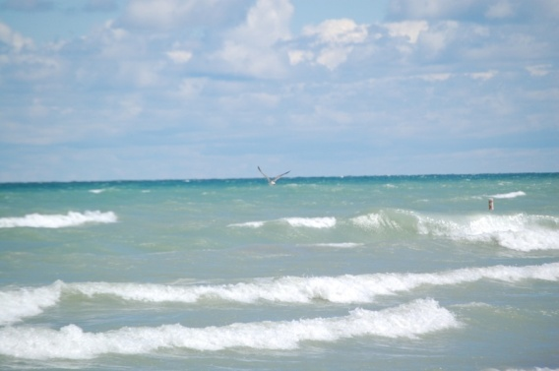

Green Alleys, Streets, and Neighborhoods
Milwaukee, Wisconsin
Urban Water Series: Strategies that Work
Greater New Orleans Foundation
June 19, 2013
Karen Sands, AICP
Manager of Sustainability
Milwaukee Metropolitan Sewerage District

Slide 3
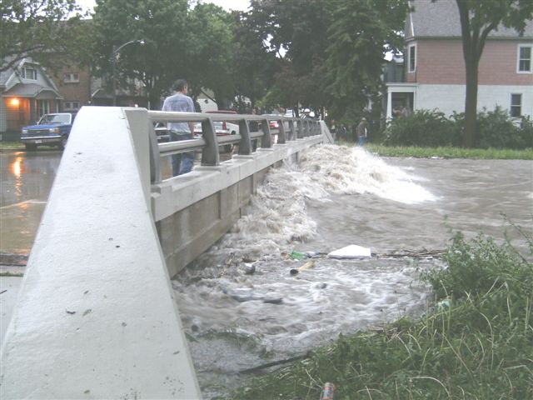
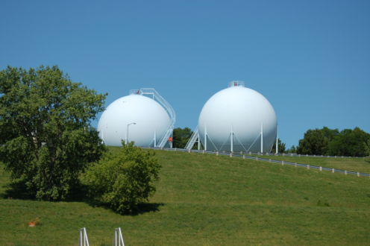
Today’s Talk…
MMSD Background
Green Infrastructure Programs
Green Infrastructure Project Examples
Questions

Slide 4
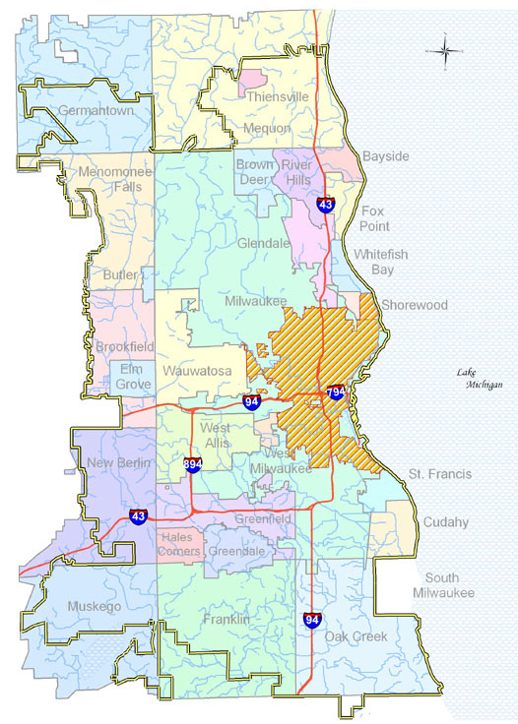
Milwaukee Metropolitan Sewerage District
We Serve:
1.1 Million Customers
28 Municipalities
411 Square Miles
Using Grey Infrastructure:
Collector Sewers
2 Treatment Plans
521 MG Tunnel Storage
To Protect the Environment:
Convey/Store/Reclaim Wastewater
Manage Flooding
Much More…

Slide 5
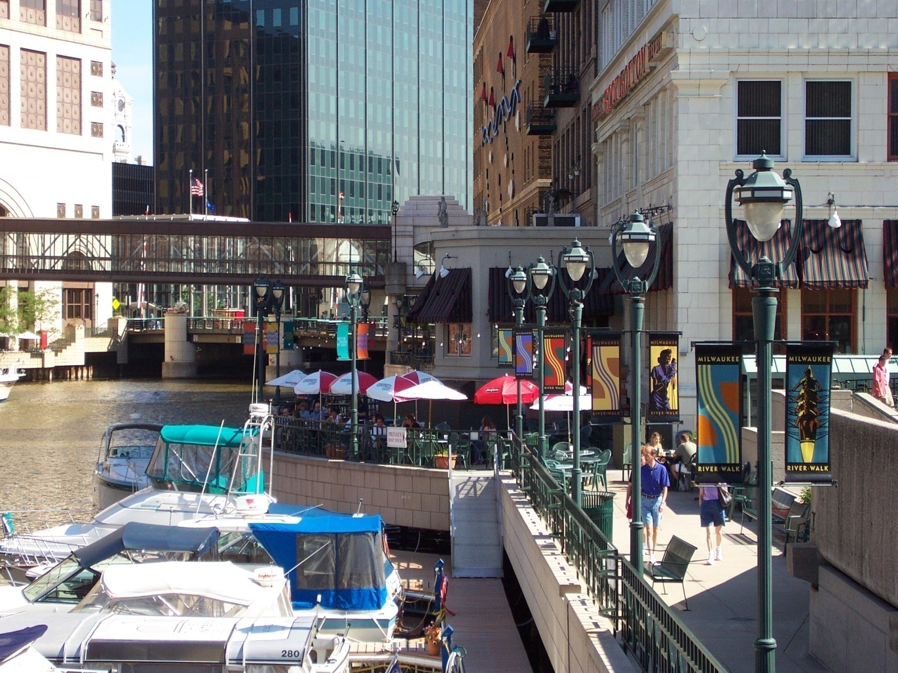
End Result!

Slide 6
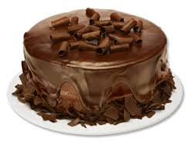
We started with a grey foundation…
  Water Reclamation Facilities
  Sewer Pipes
  Storage Vessels
And are topping it off with green…
  Green Roofs
  Rain Gardens
  Bioretention
  And More!

Slide 7
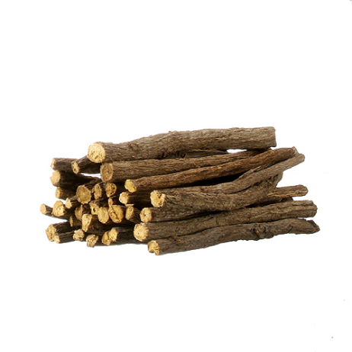

MMSD’s Approach to Green Infrastructure
Regulations
  Chapter 13
  Municipal Codes/Ordinances Review
Education/Information:
  www.h2ocapture.com
  Studies: Property Values, Triple Bottom Line Calcs
Green Infrastructure Programs
  Rain Barrels Sales
  Rain Garden Plant Sales
  Green Roof Program
  Green Infrastructure Partnership Program
Green Infrastructure Project Examples…

Slide 8
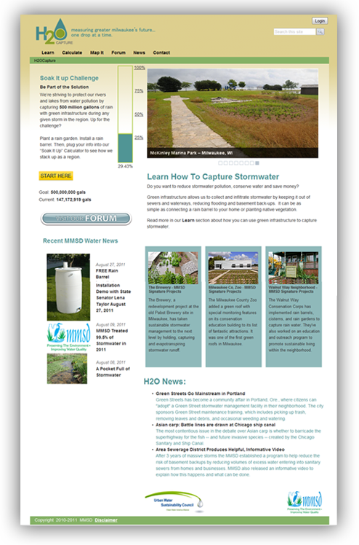
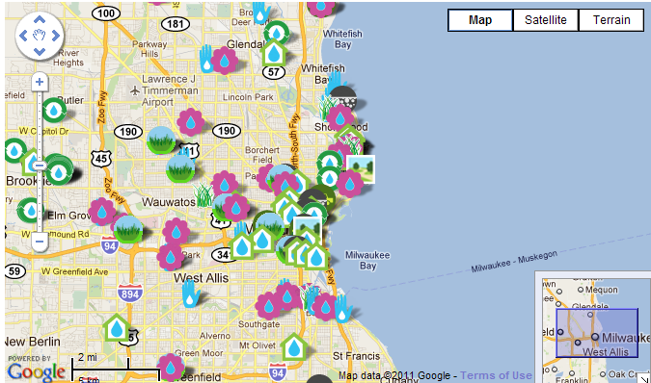
www.h2ocapture.com
Public Education

Slide 9
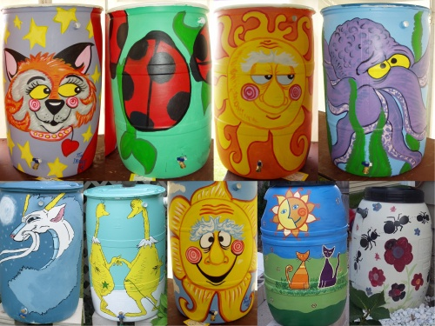
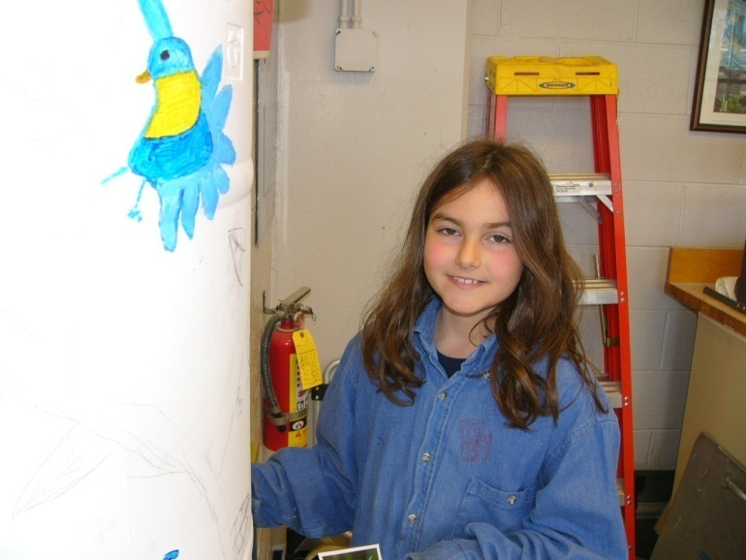
Rain Barrels
Over 18,000 Sold
Over 1,000,000 Gallons/Event
Benefits in Milwaukee
  Educational Tool
  Interest Growing (gateway “drug” to green stormwater management)
  Visual Reminder
  Changing How Future Generations Think

Slide 10
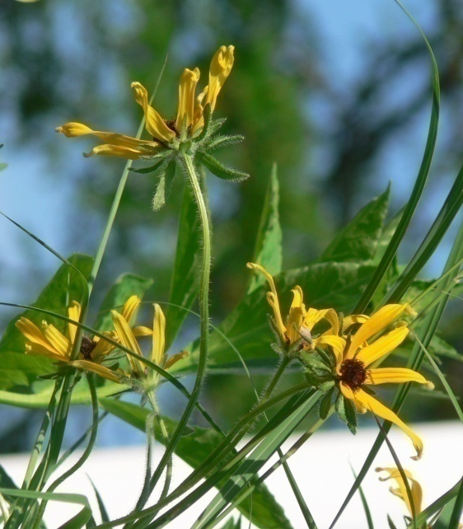

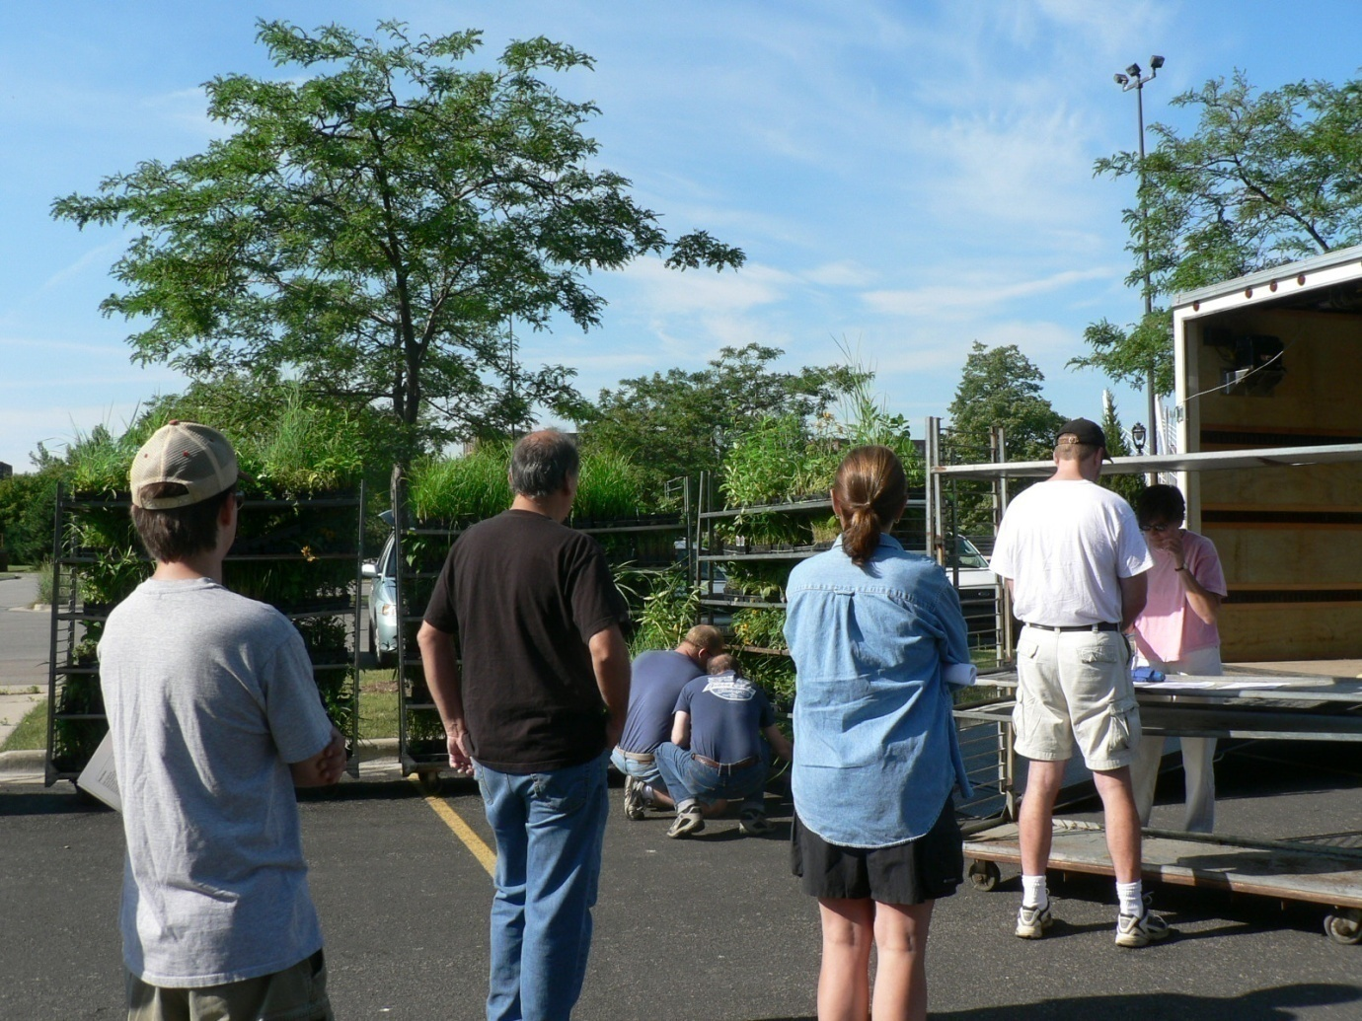
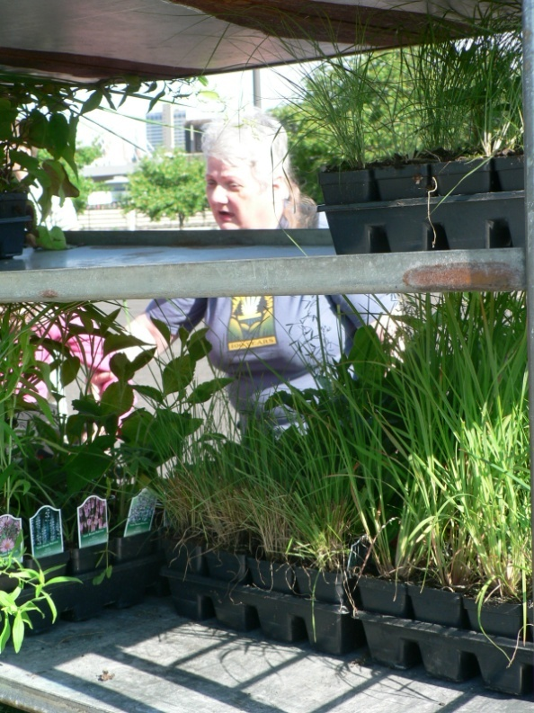
Lake Michigan Rain Garden Initiative
Over 26,000 plants sold since 2006

Slide 11
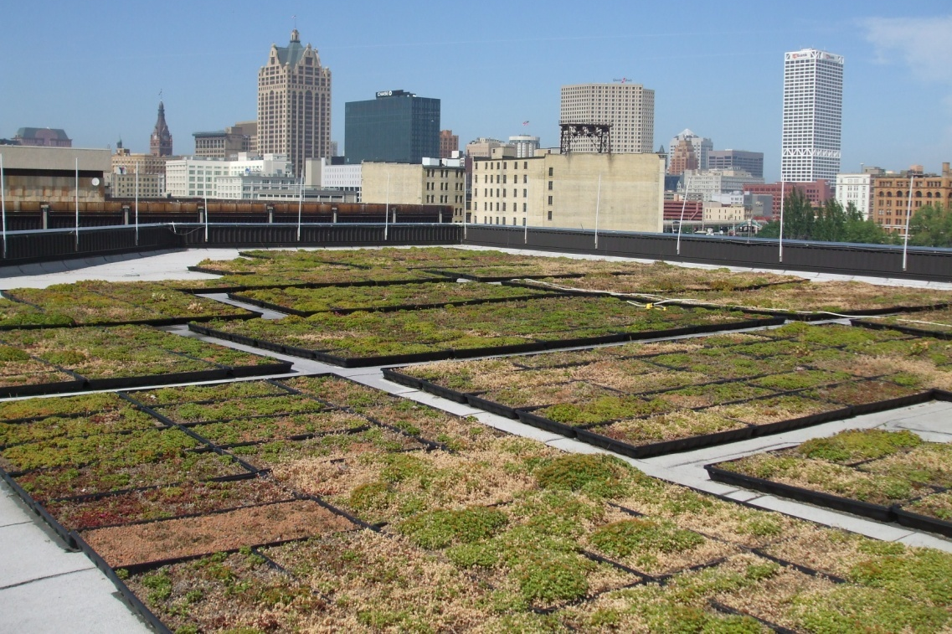
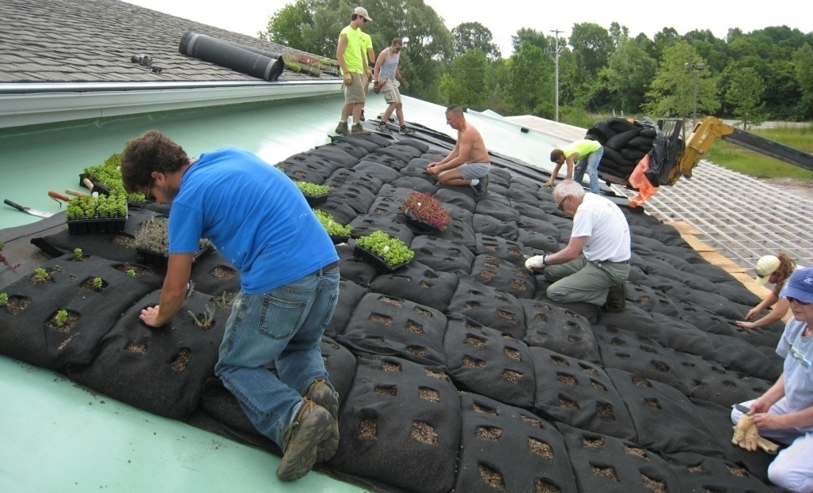
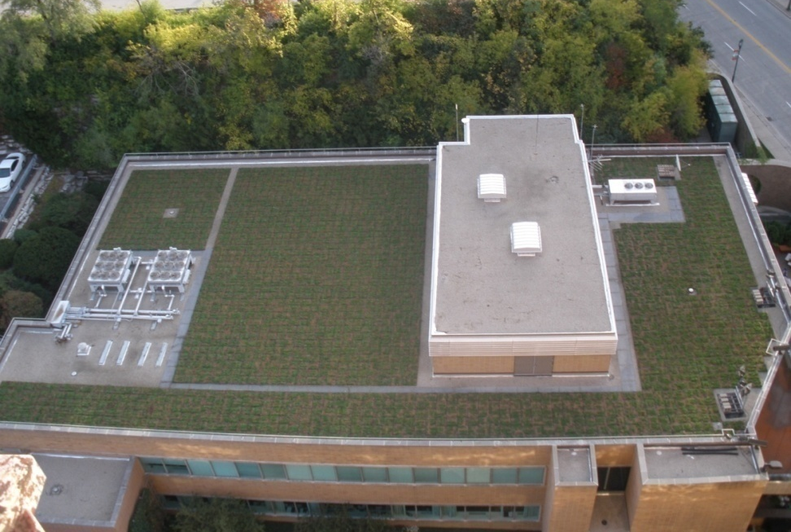
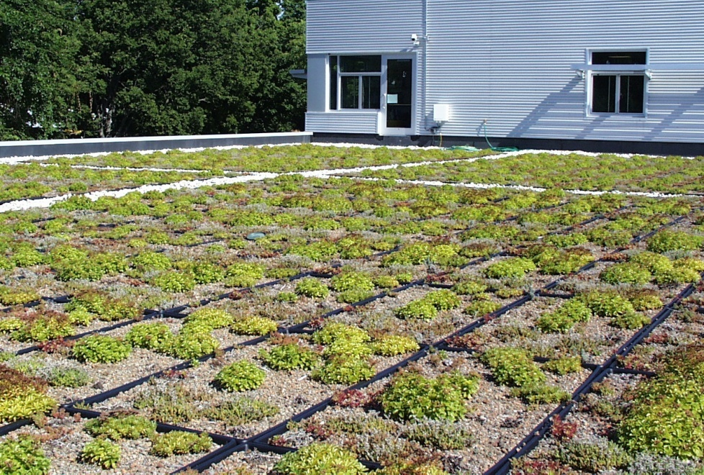
Green Roofs
Mequon
MMSD
MillerCoors
8.4 acres
Milwaukee
County
Zoo

Slide 12
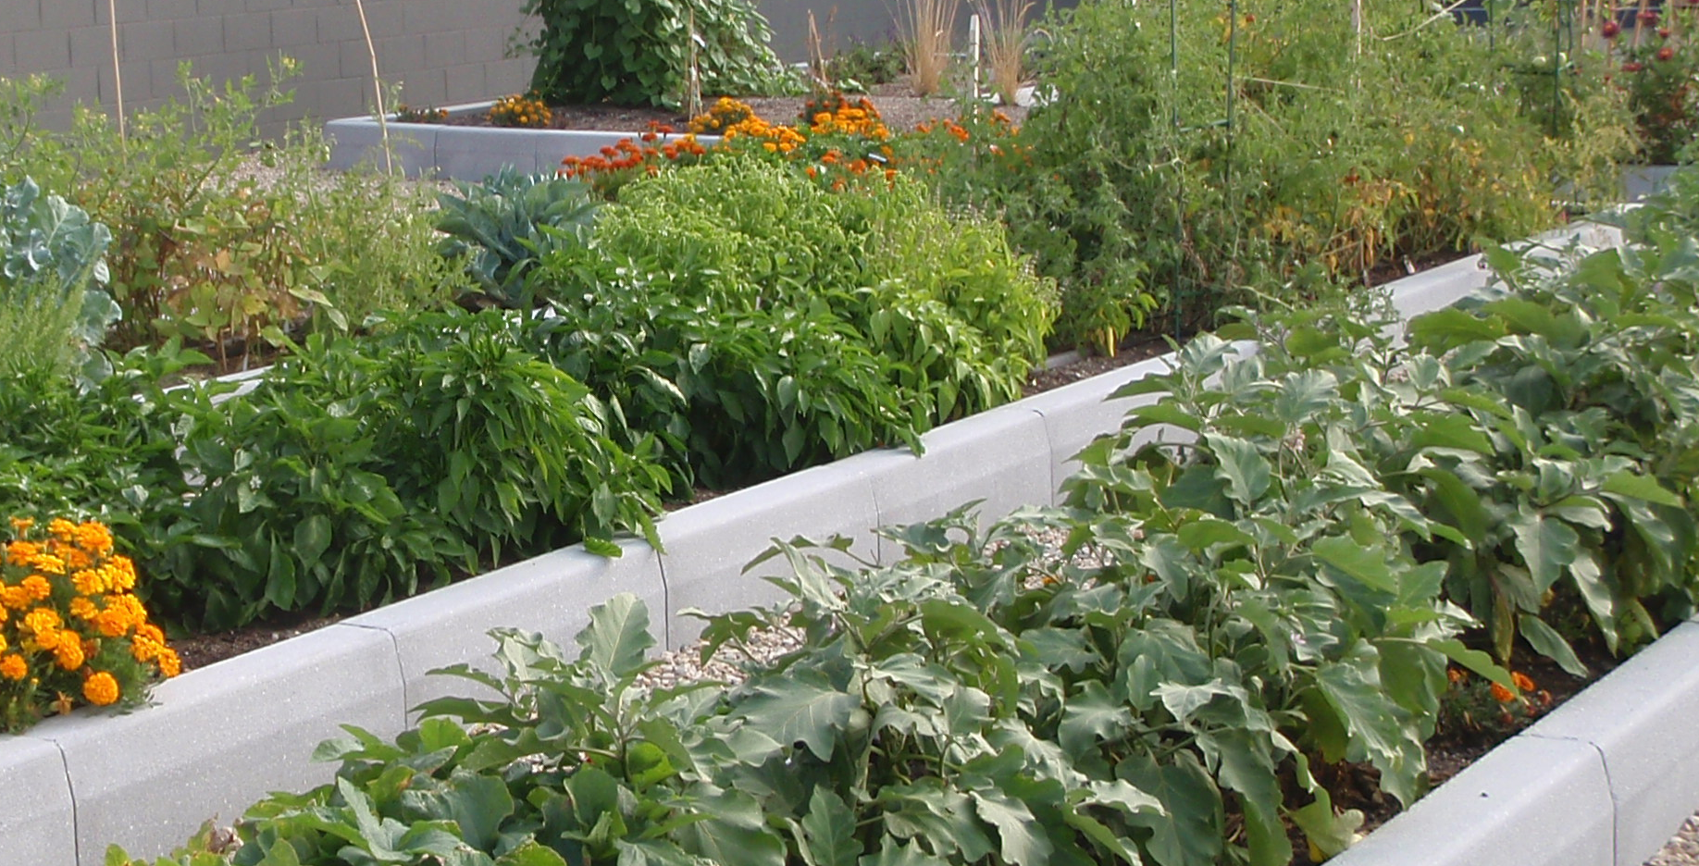
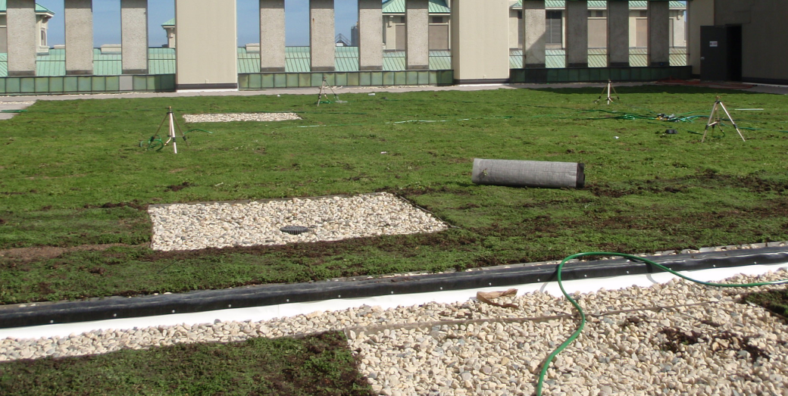
More Green Roofs
Rockwell International
Clock Shadow Building

Slide 13
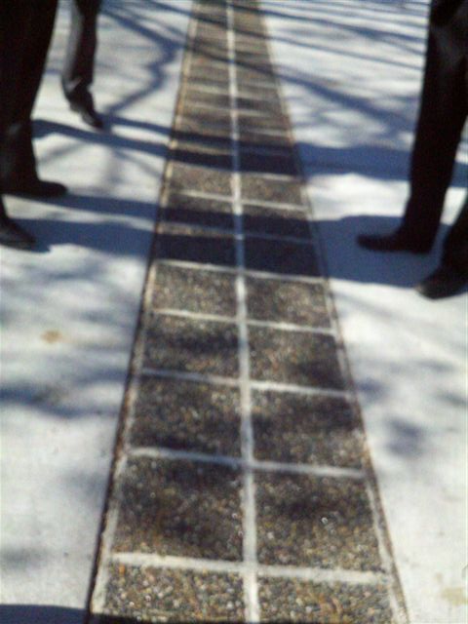
Milwaukee’s Porous Alleys
Southlawn, Housing Authority of the City of Milwaukee
Center Porous Strip to Minimize Costs
Open graded stone spans the entire width
Two Types:
  Porous Segmental Blocks (shown)
  Continuous Concrete Strip
Evaluation Part of Milwaukee’s New Approach to Standard Street Design

Slide 14
Milwaukee’s Green Street Standard
Framework to Provide Consistent Guidance Across DPW
Improve Drainage
Reduce the Cost of Implementation
Achieve Multiple Benefits

Slide 15
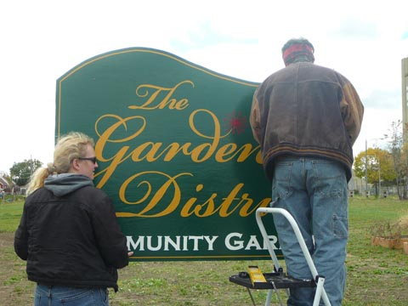
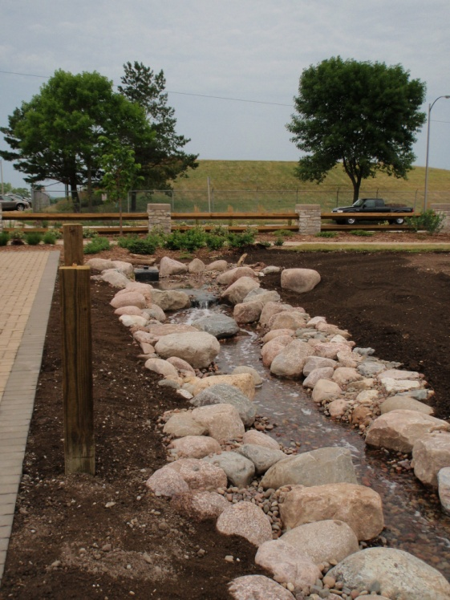
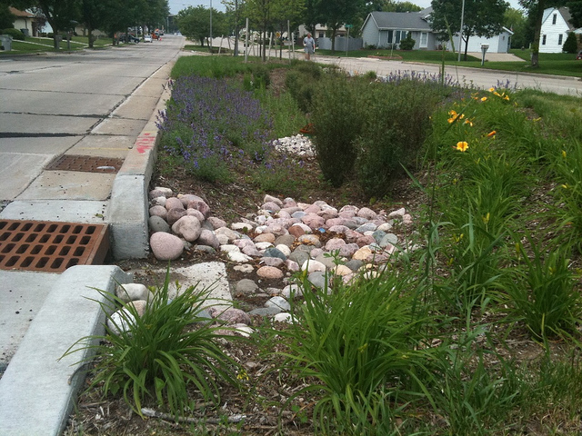
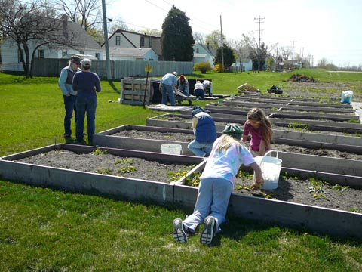
S. 6th Street
Green Corridor: Bioswales, Aquablox System, Cisterns, Permeable Pavement Sections, Native Landscaping, and Stormwater Trees.

Slide 16
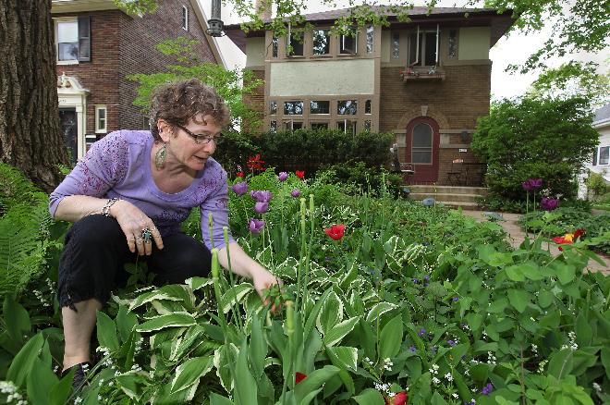
Neighborhood Implementation, Shorewood, WI
Green Infrastructure Avoided Pipe Upsizing
Result:
  Downspout Disconnections: 985 (241 homes)
  Rain Barrels: 268
  Rain Gardens: 61
Photo: Milwaukee Journal Sentinel

Slide 17
Did the Shorewood Project “Work”?

Slide 18
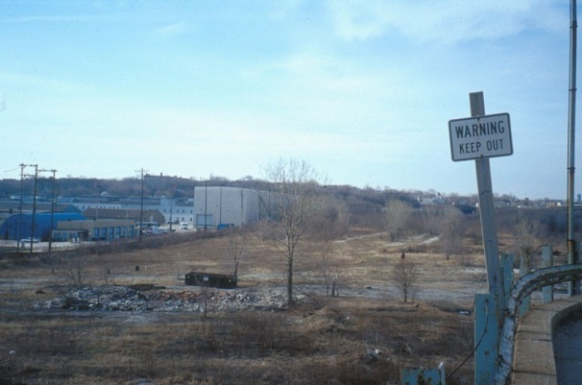
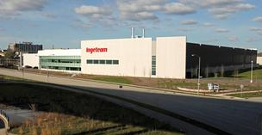
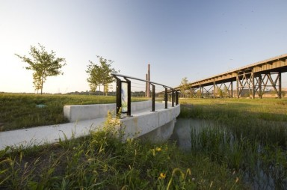
Menomonee Valley
Brownfield Redevelopment
Includes Bioretention, Flood Management, Native Landscaping

Slide 19
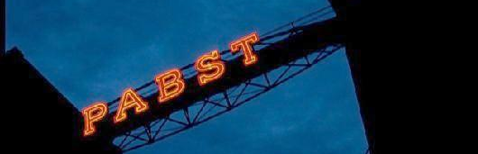
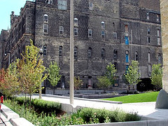
The Brewery
Urban Adaptive Reuse
Includes: bioswales, pervious pavement, underground catchment, street trees and green roofs

Slide 20
Green Infrastructure In Our New Permit
4.10 Wet Weather Management – Green Infrastructure
“…The practices/control measures put in place in 2013 must cumulatively have a design retention capacity of at least 1 million gallons, and each following calendar year during the permit term an additional 1 million gallons of green infrastructure retention capacity must be put in place...”

Slide 21
Questions?
Karen Sands, AICP
Manager of Sustainability
Milwaukee Metropolitan Sewerage District
ksands@mmsd.com

